Slide 1

DECIDE AND PROVIDE
PANEL DISCUSSION
GLENN LYONS – UNIVERSITY OF THE WEST OF ENGLAND
LYNN BASFORD – BASFORD POWERS
NICK RABBETS – TRICS CONSORTIUM LIMITED
Notes:
Welcome back from the coffee break – We are now moving into the Decide and Provide Panel Discussion.
Originally this section was going to be split into 2 separate standard presentations on Decide and Provide. But we decided that as quite a bit has progressed since the publication of the Decide and Provide Guidance and it would be more beneficial to take some of the questions we have been asked over the past 18 months or so and try and address some of them.

Slide 2
Introduction
2016 – Lyons & Davidson – ‘Guidance for Transport Planning and Policymaking in the face of an uncertain future’
2016 – CIHT Futures Initiative (Lyons) – ‘Which Way Forward for Transport?’
2017 – Government Office for Science – ‘The Futures Toolkit’
2018 Commission on Travel Demand – ‘All Change? The Future of Travel Demand and the Implications for Policy and Planning’
2019 – CIHT – ‘Better Planning, Better Transport, Better Places’
Notes:
Firstly I think it would be an idea to do a quick summary of what has happened so far in the lead up to Decide and Provide.
Here is a list of just a few of the documents published that have had an influence upon Decide and Provide.
As you can see from all the documents listed here, recognition of the need to change the way transport planning is undertaken has been in the pipeline for some time now. These documents stress the need to consider the uncertainty of the future and the need to change the way in which we look at how we should influence travel behaviours.
The 2018 All Change document states that the assumptions developed during decades of planning for growing car ownership, which underpinned our understanding of travel demand growth “are now limited and sometimes wrong”
The 2019 CIHT Better planning, better transport better places document identifies the Scourge of Predict and Provide and associated outdated assessment methodologies as a barrier to better planning.
These documents and many more asked questions of the future and how we could change the way we do things as an Industry

Slide 3
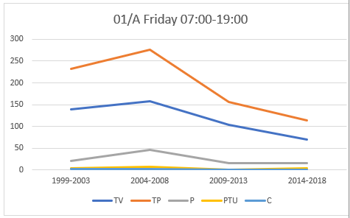
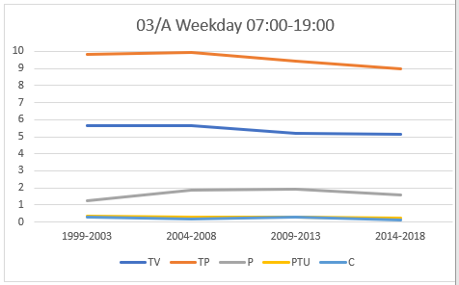
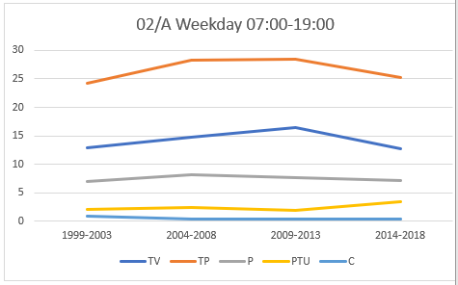
Inception of Decide and Provide (TRICS)
TRICS users started to ask questions upon how Transport Planning could change.
2019 – TRICS Technical Analysis – Trip Rate Changes over Time
2019 – TRICS Technical Note – Changes in Behaviour (Lynn Basford)
Presented by Mike Green and Lynn Basford at the 2019 User Meeting
Food Superstore Total Trips
Houses Privately Owned Total Trips
Offices Total Trips
Notes:
As a first step TRICS decided to look at the vast number of surveys within it’s database to see if what Academia was suggesting with regards to changes in Travel Behaviours was actually seen at the site level, or whether these changes were just being seen at a higher level.
The Technical Analysis and the Technical Note proved quite a success as it showed that, over the main land uses examined, changes in trip rates were observed between the various years examined and these were similar to the analysis the DfT had undertaken using the National Travel Survey.
It also showed that the historic data within the database was of high value when looking at historic trends.
However, these documents did not answer the more pressing needs of the Industry. A document was needed to assist everyone in implementing all of the advice given in the raft of publications over the past 4 or 5 years. It is at this point where we decided to combine forces with Lynn Basford and Glenn Lyons in producing the Decide and Provide Guidance Document.

Slide 4
Aim of Decide and Provide Guidance
Pull together the information contained within the numerous documents produced by Government, Academia and other professional bodies to create a coherent summary.
Provide an explanation of what Decide and Provide means to the industry and how it differs from Predict and Provide.
Show a path of how Decide and Provide can be applied to developments within the planning process.
Give advice upon each section of this path and the key points of importance.
Include examples of actual and theoretical developments that use Decide and Provide.
Notes:
After a number of lengthy meetings it was decided that the aim of the D & P Guidance document was to
As you can see it was quite a formidable task to undertake.

Slide 5

Decide and Provide Guidance – The Early Stages
April 2020 - Initial stages of discussion and aims of the document.
June 2020 – Structured interviews with Decide and Provide Consultation Group.
September 2020 – Section One of document drafted
December 2020 – Section Two of document drafted
February 2021 – Document published
Notes:
Right from the beginning it was realised that a project of this magnitude would need more than just 3 people’s insights. For this reason we asked a number of other people and organisations to assist in the process, thus ensuring that the document covered as many angles as possible, from Consultants and Local Highway Authorities to the DfT. As you can see from the list of acknowledgements included within the document, there was quite a varied range of participants.

Slide 6

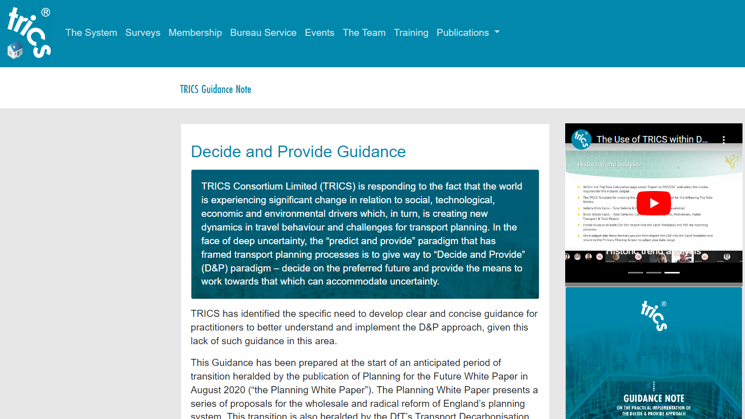
Decide and Provide Guidance – Published
Notes:
The Guidance document itself has been made available to the TRICS Community in a number of ways.
For those of us who are old school – you can actually purchase a physical copy of the document, which I understand is quite handy to wave around whilst trying to prove your point. It’s also easier to place little bookmarks in so you can easily find things whilst in Committee or at Inquiry. We still have a very limited number of physical copies left, so you can come and see me after if you are interested.
There is also the download version available on our website. From the TRICS Home Page, go to ‘Publications’ and select ‘Decide and Provide’ to take you to the dedicated D&P pages.

Slide 7
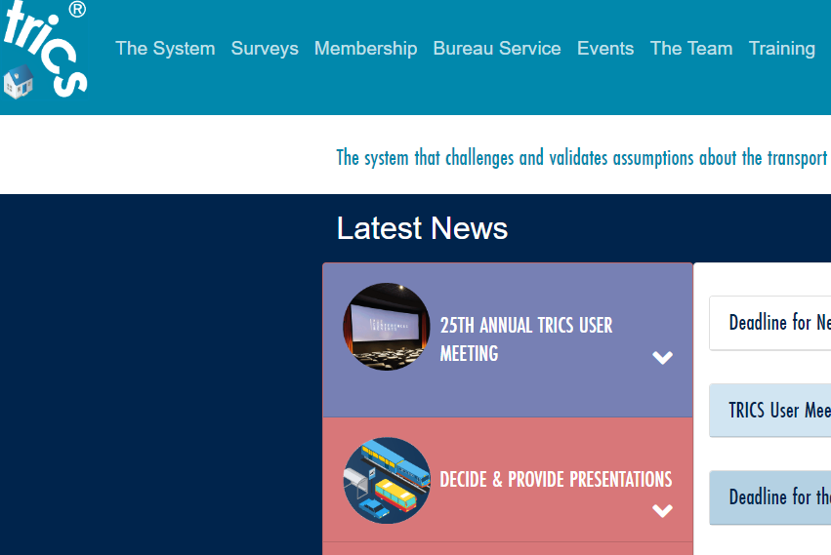
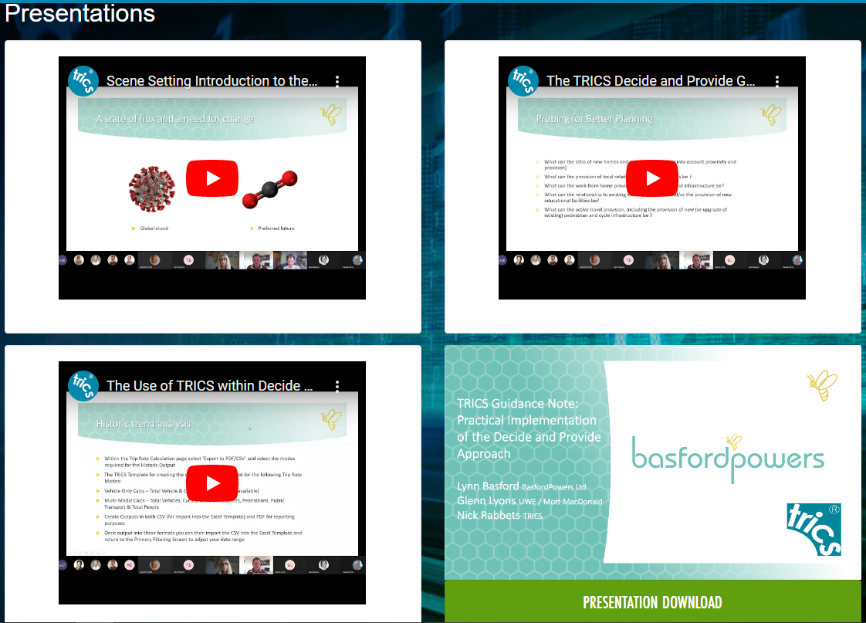
Previous Presentations
Notes:
During the period of Covid Lock-down and the various restrictions we were all under. Lynn, Glenn and myself were invited to attend a number of online presentations. These have been recorded and can be viewed from the TRICS website. If you select the ‘Decide and Provide Presentations box it will take you to a dedicated page were you can download the PowerPoint presentation and then listen to us presenting our relevant sections.

Slide 8

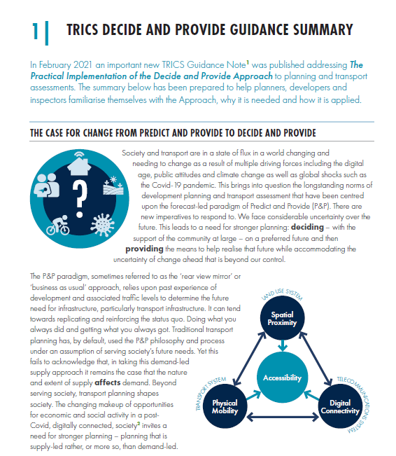
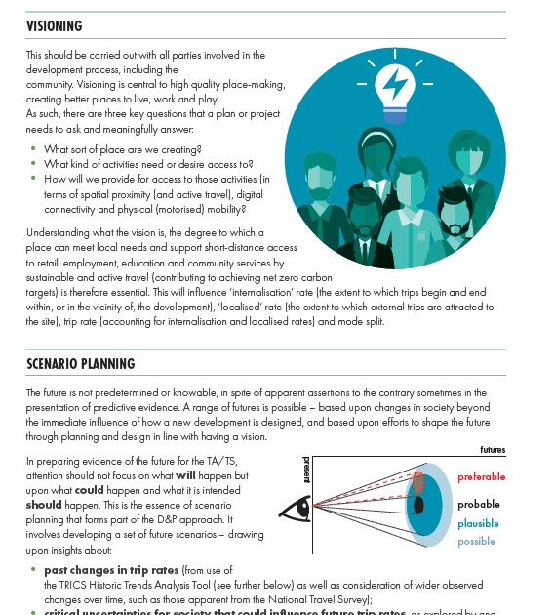
Decide and Provide Guidance Summary – Published
http://trics.org/publications.html#nav-contact
Notes:
Since the publication of the full guidance document there have been requests for a condensed version aimed at decision makers and those commissioning Transport Assessments.
There is a download version available on our website. From the TRICS Home Page, go to ‘Publications’ and select ‘Technical Notes and Guidance’ and then Decide and Provide.

Slide 9
PANEL DISCUSSION
Panel Members
Lynn Basford – Basford Powers
Glenn Lyons – University of the West of England
Nick Rabbets – TRICS Consortium Limited
Notes:
We now move onto the Panel Discussion. The Members of the Panel are the main Authors of the Decide and Provide Guidance Note.
Lynn Basford from Basford Powers
Glenn Lyons from University of West of England
And Myself
Over the past few months we have all dealt with Decide and Provide questions from the TRICS Community and you all have been asked to provide questions prior to the meeting for this section. We will also have time towards the end of this session to take questions from the floor.

Slide 10
PANEL DISCUSSION
Why do we need to change from Predict and Provide?
Notes:
The first question is one that we have all been asked frequently by may different areas of the Transport Planning Industry.

Slide 11
PANEL DISCUSSION
Is the Visioning process really needed?

Slide 12
PANEL DISCUSSION
Many people are struggling with the concept of multiple Forecasting Scenarios, how would you undertake the process?

Slide 13
FORECAST SCENARIOS
Use RTF18 and Tempro to factor base year survey data with no development. If development is an allocated site within Local Plans, remove it from Tempro by adjusting planning assumptions, thus avoiding double counting.
Choose a number of forecast scenarios for the Base ‘No Development’ Options. RTF18 Sc1 appears to be the same as TEMPRO 8 Core.
Notes:
I have spoken to DfT with regards to this and Tempro8, which is being released very shortly should be able to undertake Local Geographical factors for a number of scenarios.

Slide 14
FORECAST SCENARIOS
Consider the surrounding highway network and decide upon what key locations are important for an initial examination. Site accesses, key junctions and crossing points.
At this stage of the process the assessment can be quite coarse, as there will be a lot of scenarios to study as the process continues. Consider using a spreadsheet to compare the various scenarios for each of the highway locations. It might not be necessary to consider turning movements at this stage, total inbound flows might suffice.

Slide 15
FORECAST SCENARIOS
Create the various Development Scenarios to calculate ‘With Development’ options. These might include:
  ‘Do Minimum’ - no non-vehicular improvements or historic trends.
  ‘Historic Trends’ - no non-vehicular improvements, but with observed historic trends from TRICS.
  Various Improvement Options – these could be many in number to test the impact of various assumptions and improvements proposed by the development.

Slide 16
FORECAST SCENARIOS
Combine the various Highway Network Base Scenarios with the Development Scenarios, for the years of assessment.
If you had 4 RTF18, 1 No Development & 5 Development Options and 3 Years of Assessment this would equate to 72 scenarios for each highway location. This is why I suggest doing this at a course level using spreadsheets.
Use this information to agree a number of most likely scenarios to fully work up to a detailed assessment. This detailed work is likely to include an increase in network junctions and crossings to that considered at the earlier stages and will require detailed turning counts. The number of detailed scenarios is likely to depend upon the size and complexity of the development and the sensitivity of the highway network.

Slide 17
PANEL DISCUSSION
How much weight can be attributed to the ‘Decide and Provide’ approach in the overall planning balance, given that the use of sustainable modes is a choice and not an obligation?

Slide 18
PANEL DISCUSSION
I find that consultants are keen to place significant weight on sustainable interventions, without considering the fallback options, and elected members are sceptical about supporting any development without any physical improvement to enhance capacity on the highway network. How can Decide and Provide work for all parties?

